Slide 1
Object oriented programming
Iván Guerrero Román

Slide 2
Session #16
Today’s topics
4. Inheritance and polymorphism
a. Concept of inheritance
b. Access modifiers
c. Concept of polymorphism
d. Overriding and overloading
e. Abstract classes and interfaces

Slide 3
Access modifiers

Slide 4
Access modifiers in Java
They determine when it is possible for other classes to have access to methods or attributes
2 levels:
Class level: Access modifier of a class
public
default
Level members of a class: Access modifier of an attribute or method
4 access modifiers:
UML notation | Name | Class | Package | Subclass | Every class
+ | public | ✓ | ✓ | ✓ | ✓
# | Protected | ✓ | ✓ | ✓ | ✗
~ | “default” (leave empty) | ✓ | ✓ | ✗ | ✗
- | private | ✓ | ✗ | ✗ | ✗

Slide 5
Class and instance attributes and methods

Slide 6
Class methods and attributes
Until now, to make use of either a method or an attribute, are called through an object.
Class methods and attributes are used when the task does not rely on any object.
To declare a class method or attribute, Java contains the keyword static
public class MyClass { public String myAttribute; public void foo() {} } | public class MyClass2 { public void goo() { MyClass obj = new MyClass(); obj.myAttribute = “value”; obj.foo(); } }

Slide 7
Class and instance attributes
In general, a class comprises two different types of attributes:
Instance: Every object has its own copy
Class: There’s one single value for all the objects
public class Person {
public int ID; //Instance
public static int nextID; //Class
}

Slide 8
Class and instance methods
Similar to the attributes, there are also instance and class methods:
Instance: Work with instance attributes, class attributes and parameters
Class: Work only with class attributes and parameters
You only need the class to be able to use them
They can not use variables or instance methods
public class Geometry {
public static double PI = 3.14159267;
//Class method
public static double determineCircleArea(double radix) {
return PI*Math.pow(radix, 2);
}
}

Slide 9
public class MyClass {
public int number;
public static int number2;
public void foo() {
int variable;
}
public void goo(int data) {}
public static void hoo(int param) {}
}
 | foo | goo | hoo
number | ☑
number2 | ☑
data | ☒
param | ☒
variable | ☑

Slide 10
public class MyClass {
public int number;
public static int number2;
public void foo() {
int variable;
}
public void goo(int data) {}
public static void hoo(int param) {}
}
 | foo | goo | hoo
number | ☑ | ☑
number2 | ☑ | ☑
data | ☒ | ☑
param | ☒ | ☒
variable | ☑ | ☒

Slide 11
public class MyClass {
public int number;
public static int number2;
public void foo() {
int variable;
}
public void goo(int data) {}
public static void hoo(int param) {}
}
 | foo | goo | hoo
number | ☑ | ☑ | ☒
number2 | ☑ | ☑ | ☑
data | ☒ | ☑ | ☒
param | ☒ | ☒ | ☑
variable | ☑ | ☒ | ☒

Slide 12
Common uses
Class variables
Use them to store common values in all the objects of a class.
Class methods
Use them when their operation does not depend on the state of the object.
They are used to create methods that provide additional usefulness to the class.

Slide 13
abstract classes and interfaces

Slide 14


By creating inheritance relationships, classes become more abstract.

Slide 15
Occasionally, classes become a basis for building new classes and do not want instances of those classes.

Slide 16
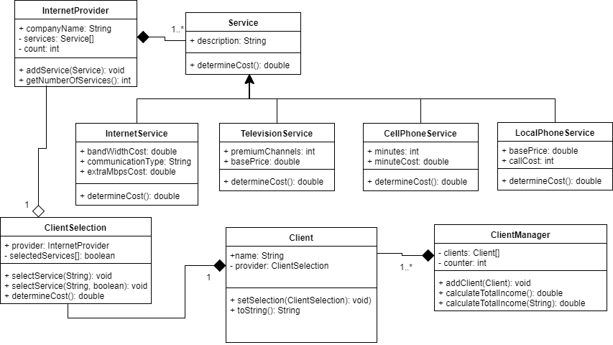

Slide 17
We don’t want, for instance, objects of the Service class.

Slide 18
When we want a class not to be instantiated, we use the abstract modifier

Slide 19

public abstract class Service {
public String description;
public double determineCost() {
return 0;
}
}

Slide 20
Besides, a class declared abstract can have unimplemented methods. These methods will be implemented in some subclass.

Slide 21
For that purpose, we can use the abstract modifier with the methods.

Slide 22
public abstract class Service {
public String description;
public abstract double determineCost();
}

Slide 23
Interfaces

Slide 24
An interface is a way of describing what a class should do, but without worrying about how it will do it.

Slide 25
This allows us to create programming contracts, that a class must fulfill when implementing an interface.

Slide 26
The interfaces are similar to abstract classes with the advantage that a class can implement multiple interfaces.

Slide 27
An interface consists of two elements:
+ Constants
+ Methods

Slide 28
Example
public interface MyInterface {
int CONSTANT_1;
void myMethod(int param);
…
}
public class MyClass implements MyInterface {
…
}
Important:
In java, all the methods of an interface are public
All the attributes of an interface are constant (they have the public, static, and final modifiers)

Slide 29
A class that implements an interface is committed to provide an implementation for each method

Slide 30
If a class does not implement all the methods of an interface, then it must be declared abstract.

Slide 31
public interface IService {
public double determineCost();
}
public abstract class Service implements Iservice {
public String description;
}
As it does not implement the method determineCost, it is declared abstract

Slide 32
Summary
Abstract classes
A class that cannot be instantiated
May contain both abstract and implemented methods
Interfaces
Contains details on what a class will implement, without including how the methods will be implemented
Its attributes can only be constants
Their methods and attributes are public
A class implements an interface with the keyword implements
A class can implement multiple interfaces (separating them by commas)
If a class does not implement all the methods of an interface it must be declared abstract

Slide 33
Session #16
Today’s topics
4. Inheritance and polymorphism
a. Concept of inheritance
b. Access modifiers
c. Concept of polymorphism
d. Overriding and overloading
e. Abstract classes and interfaces

